Slide 1

Housing Society Management Software
(Echo Software Consultancy Services)
Desktop / Online Website / Online Android / Off line Android
https://www.echonet.in/Housingsociety.htm
https://www.echonet.in/HousingsocietyOnLine.aspx
https://www.echonet.in/AndroidSocietyOnline.htm
https://www.echonet.in/AndroidsocietyOffLine.htm

Slide 2
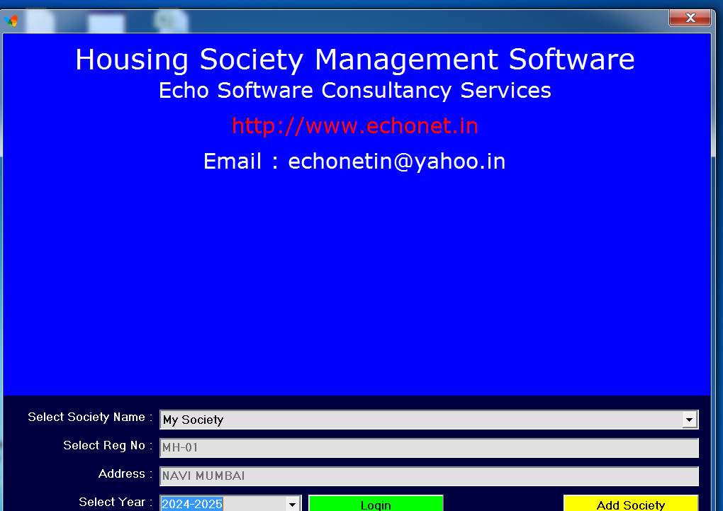
Housing Society Management Software
Desktop (Windows Based)

Slide 3
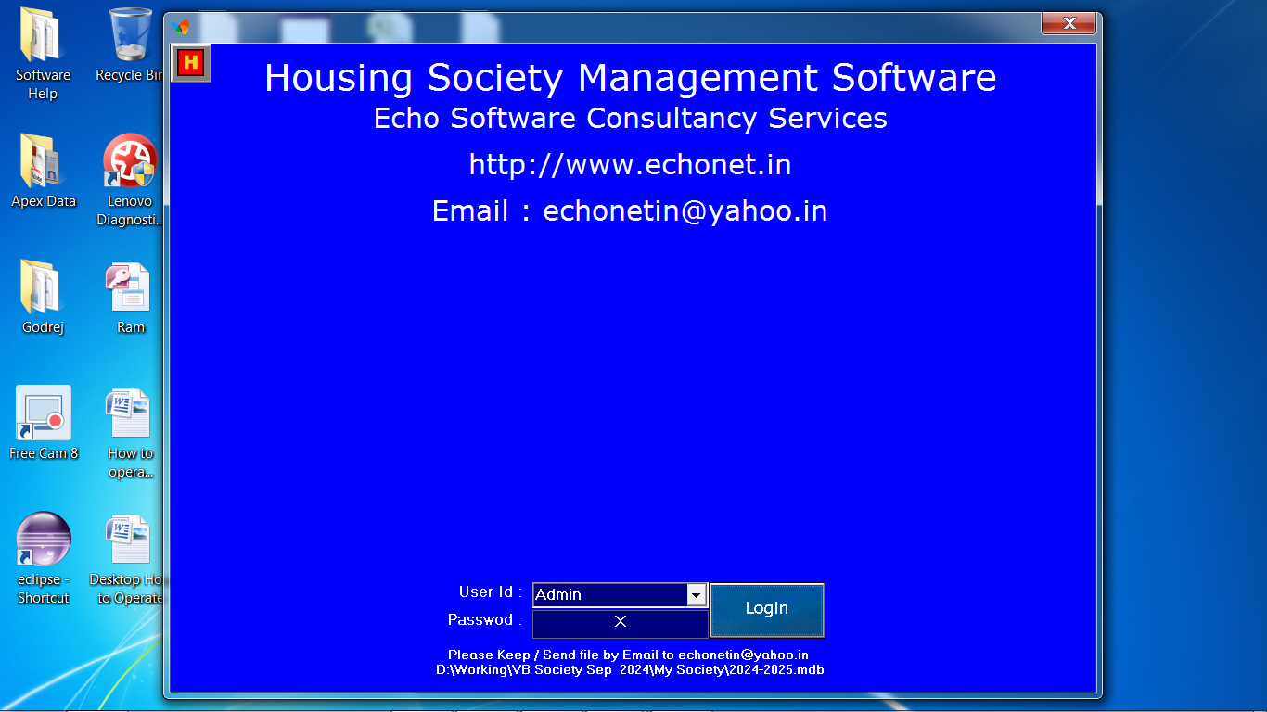
Housing Society Management Software
Desktop (Windows Based)

Slide 4
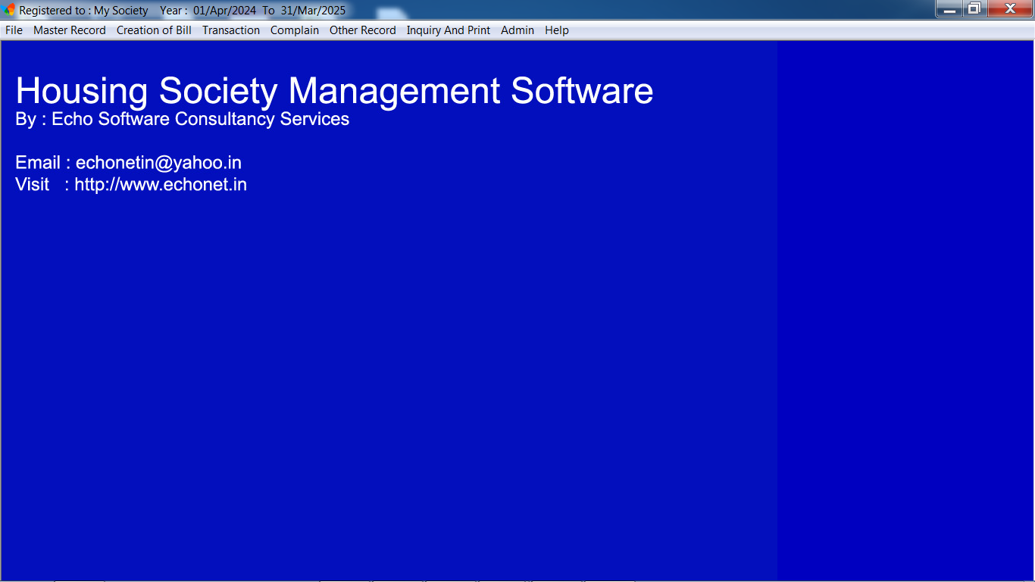
Housing Society Management Software
Desktop (Windows Based)

Slide 5
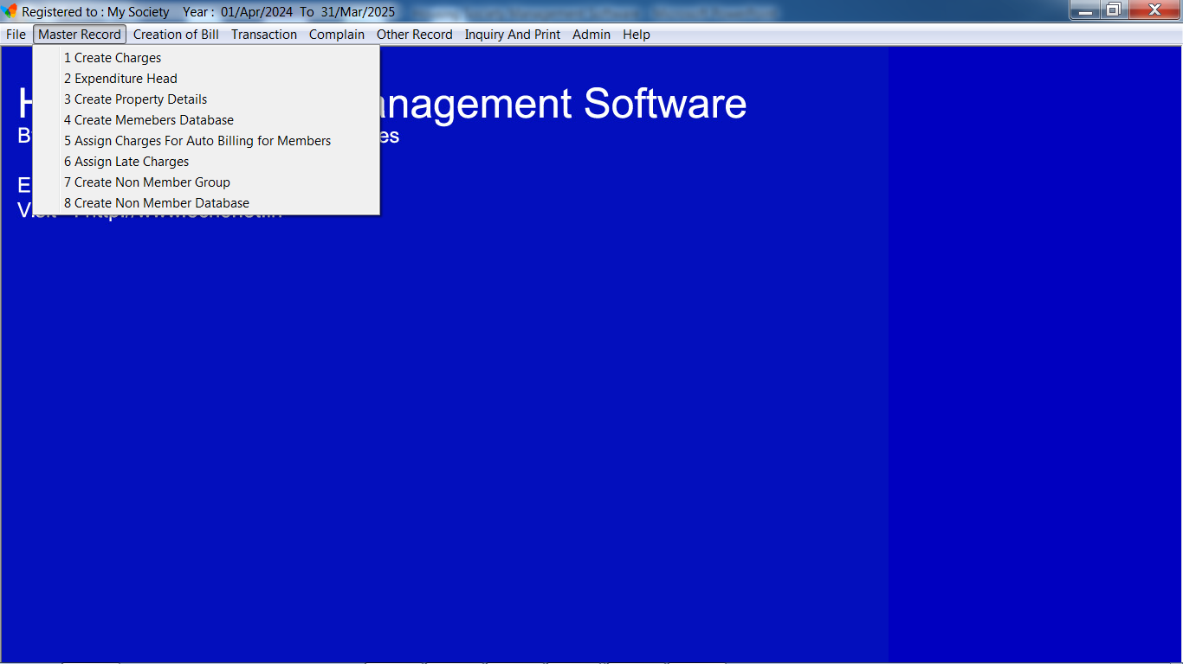
Housing Society Management Software
Desktop (Windows Based)

Slide 6
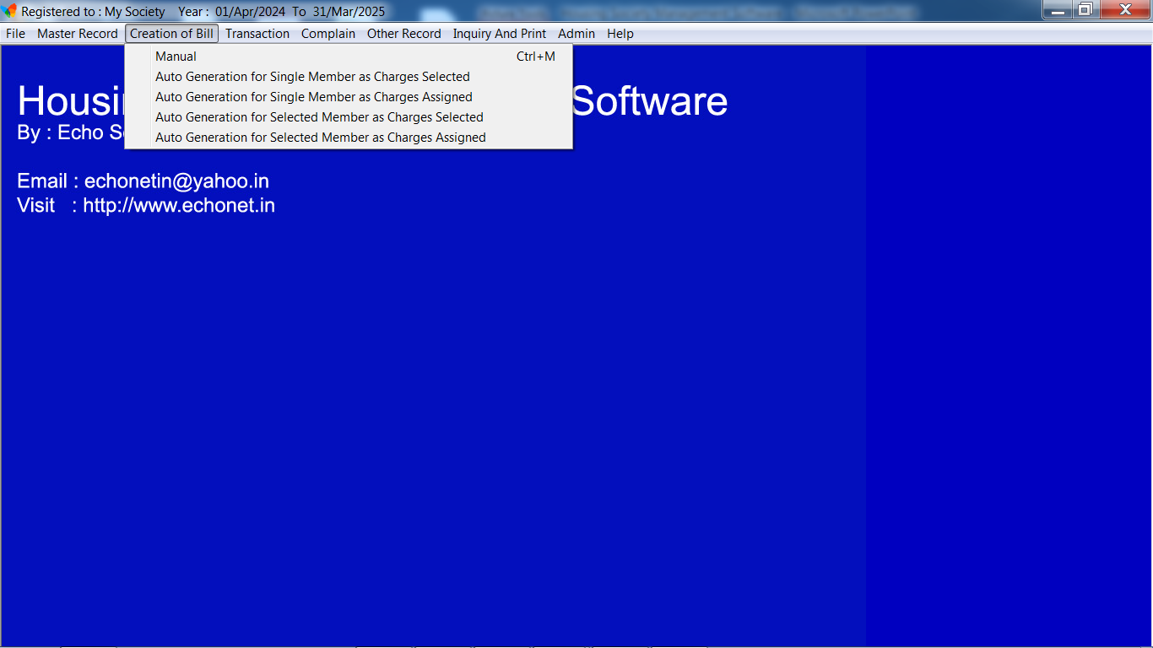
Housing Society Management Software
Desktop (Windows Based)

Slide 7
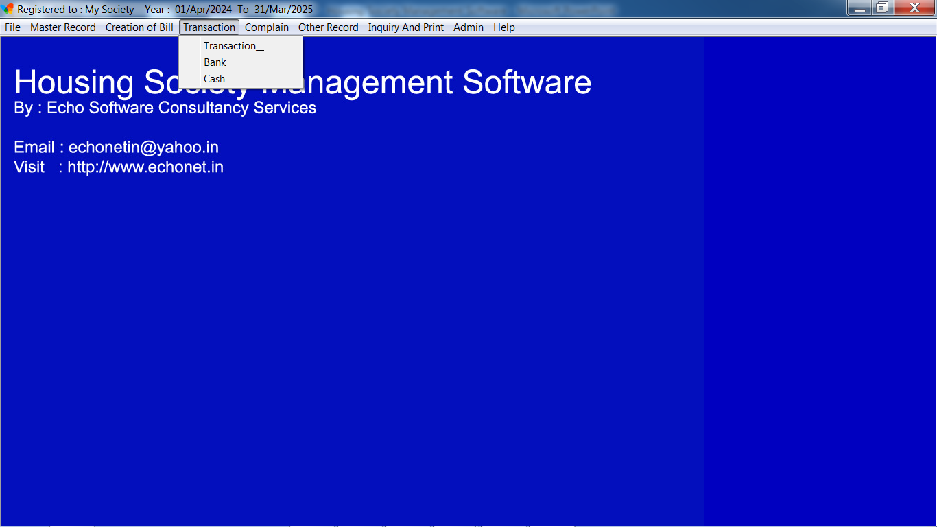
Housing Society Management Software
Desktop (Windows Based)

Slide 8
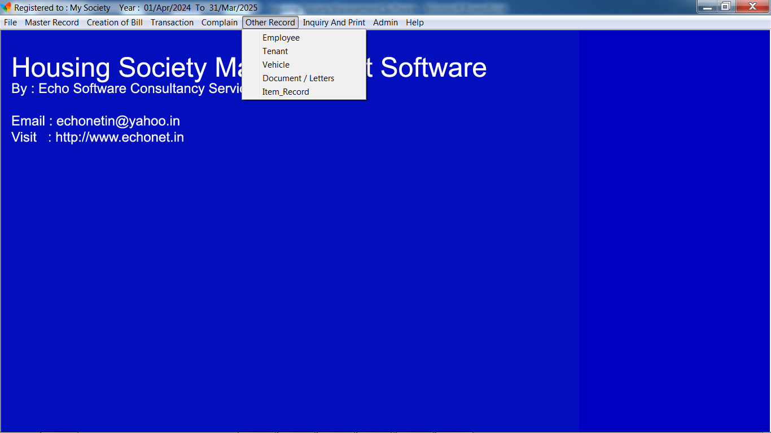
Housing Society Management Software
Desktop (Windows Based)

Slide 9
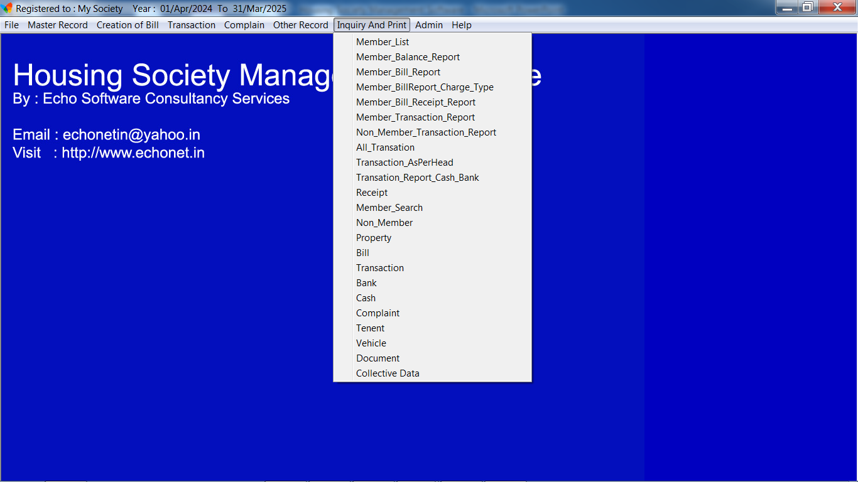
Housing Society Management Software
Desktop (Windows Based)

Slide 10
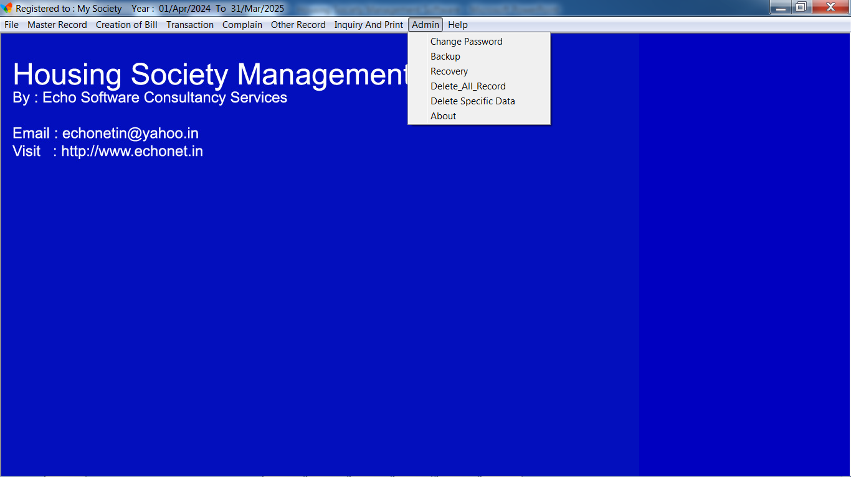
Housing Society Management Software
Desktop (Windows Based)

Slide 11
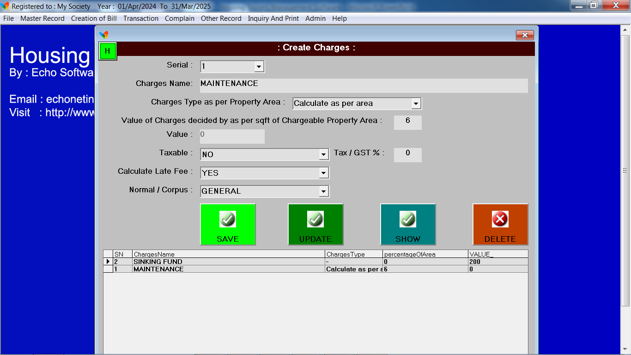
Housing Society Management Software
Desktop (Windows Based)

Slide 12
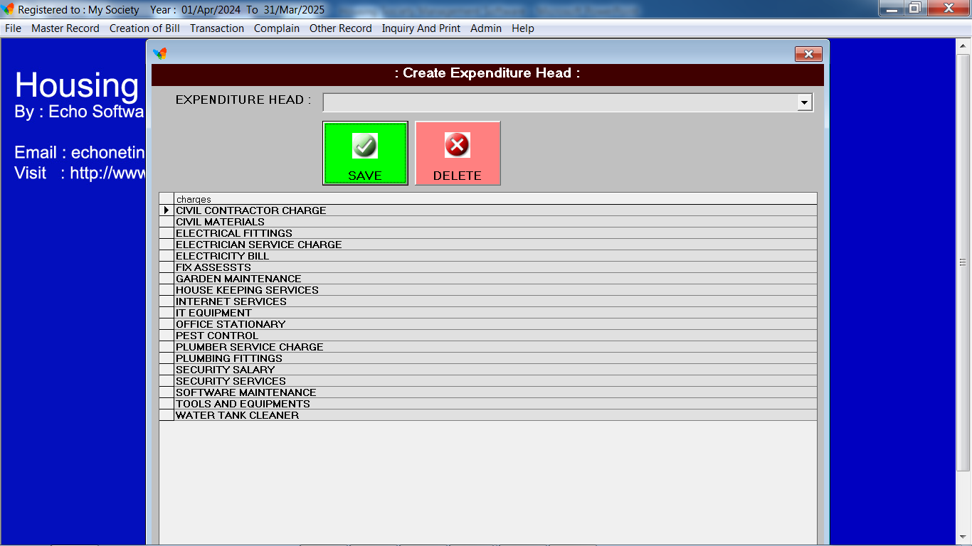
Housing Society Management Software
Desktop (Windows Based)

Slide 13
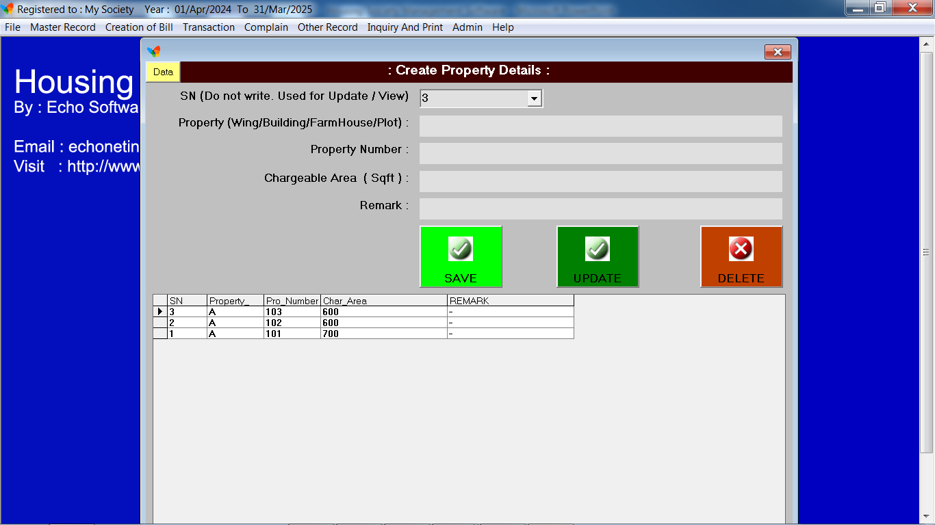
Housing Society Management Software
Desktop (Windows Based)

Slide 14
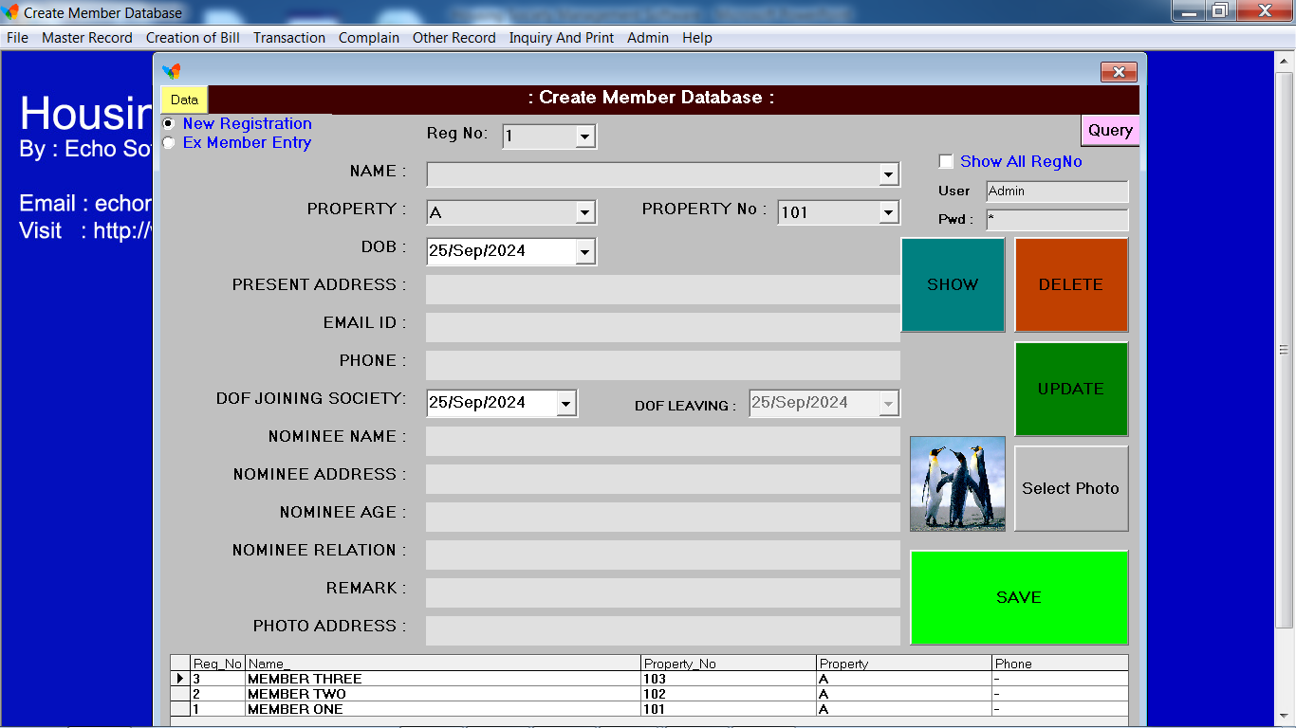
Housing Society Management Software
Desktop (Windows Based)

Slide 15
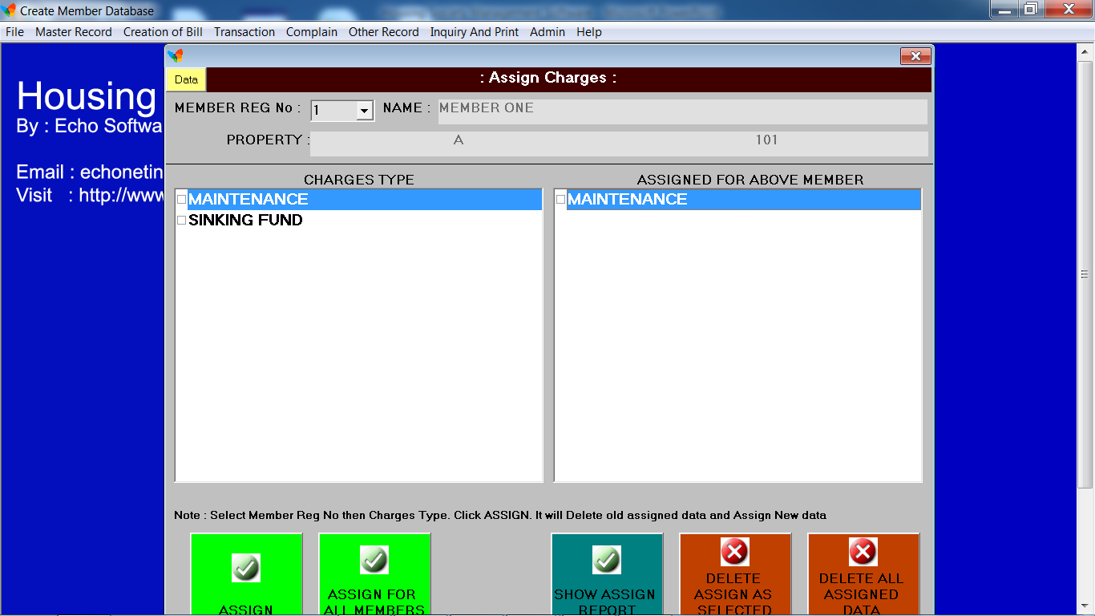
Housing Society Management Software
Desktop (Windows Based)

Slide 16
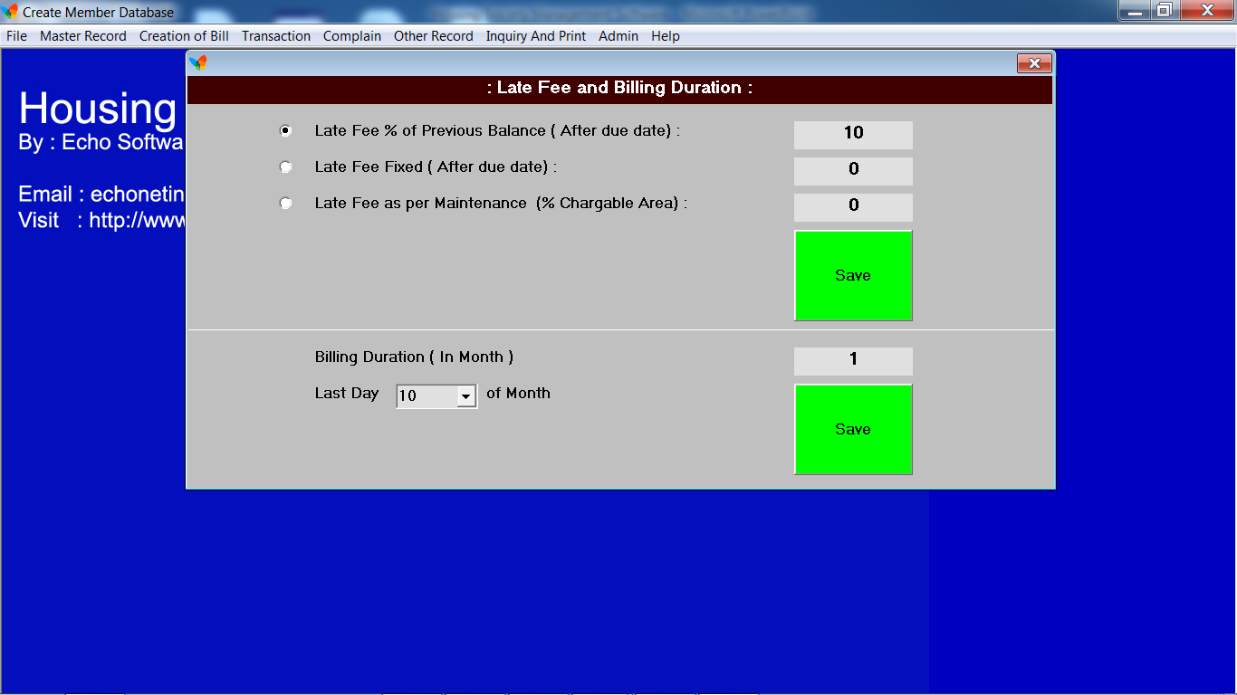
Housing Society Management Software
Desktop (Windows Based)

Slide 17
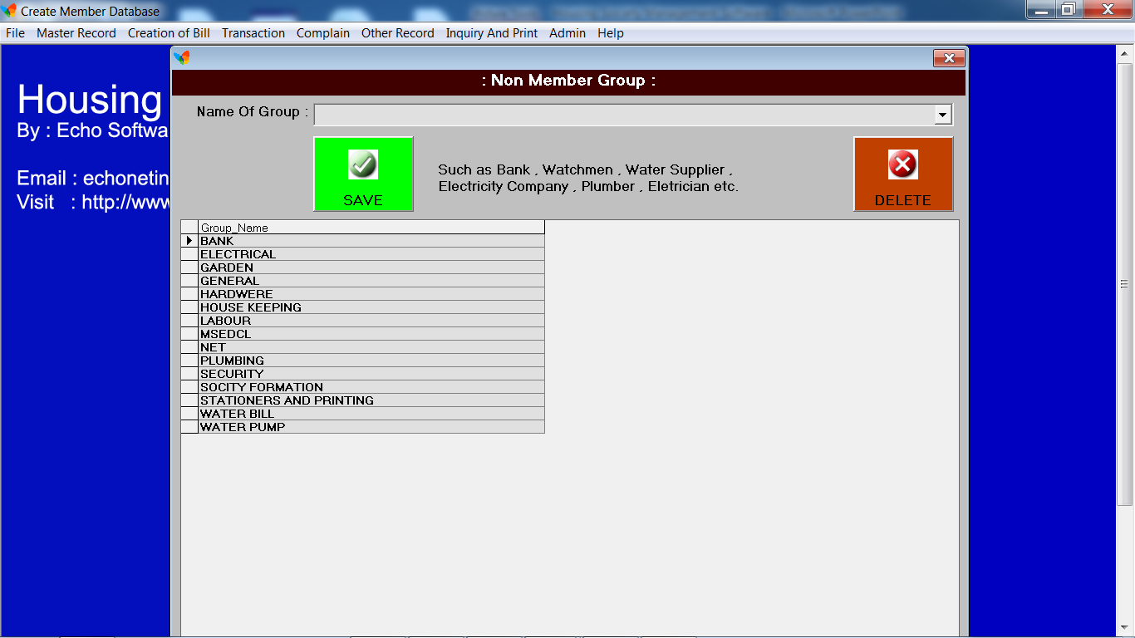
Housing Society Management Software
Desktop (Windows Based)

Slide 18
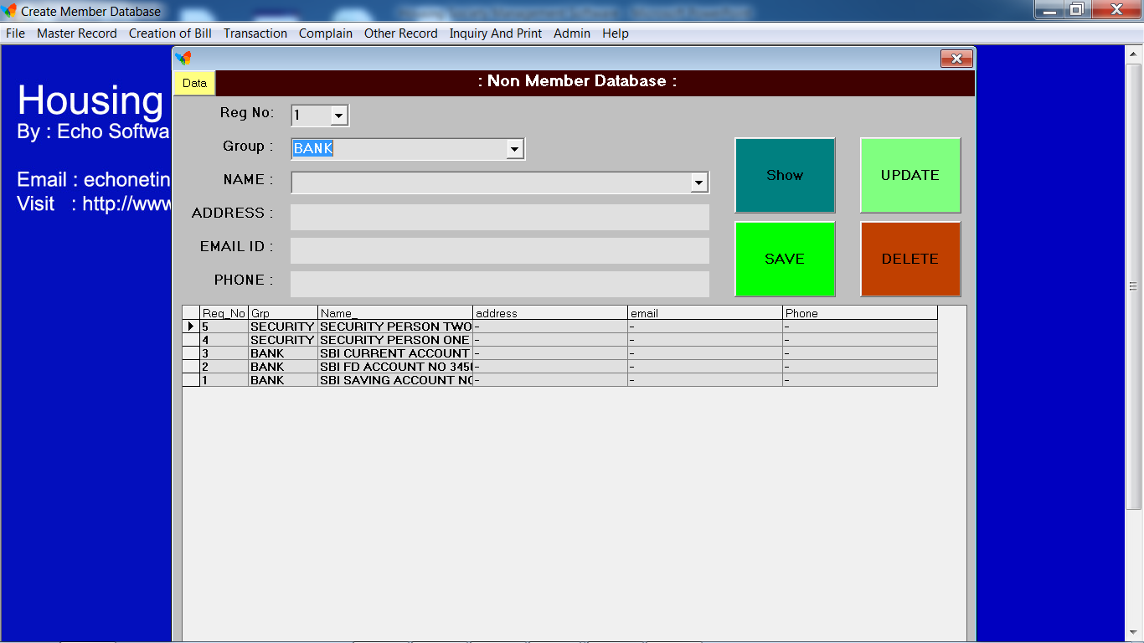
Housing Society Management Software
Desktop (Windows Based)

Slide 19
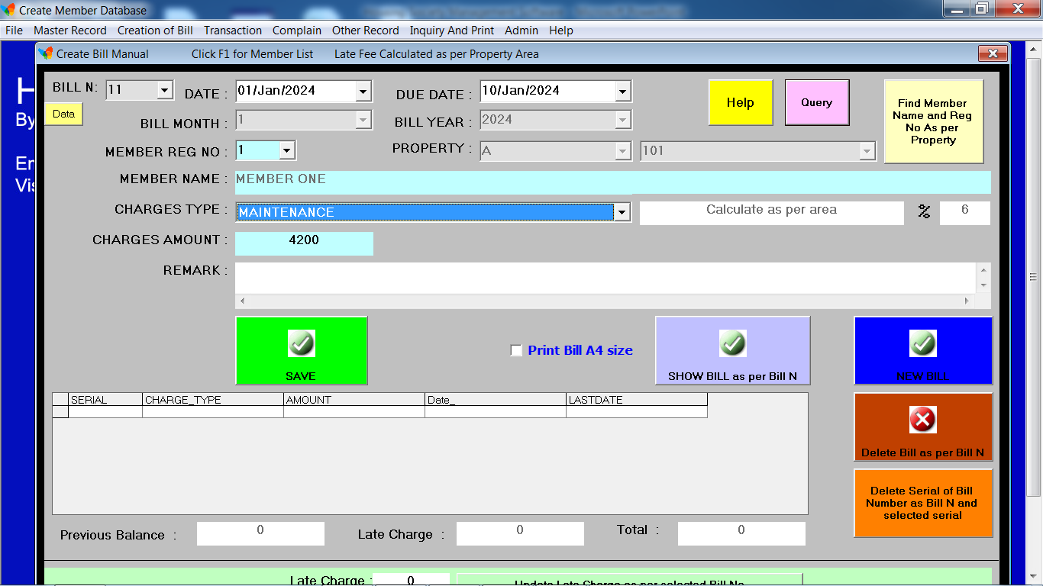
Housing Society Management Software
Desktop (Windows Based)

Slide 20
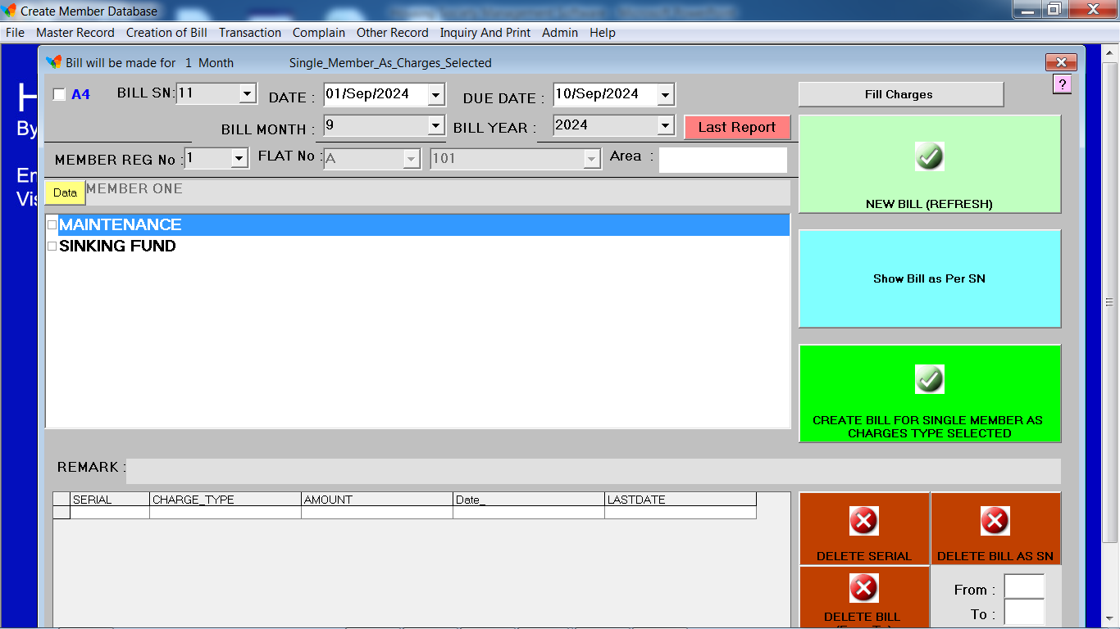
Housing Society Management Software
Desktop (Windows Based)

Slide 21
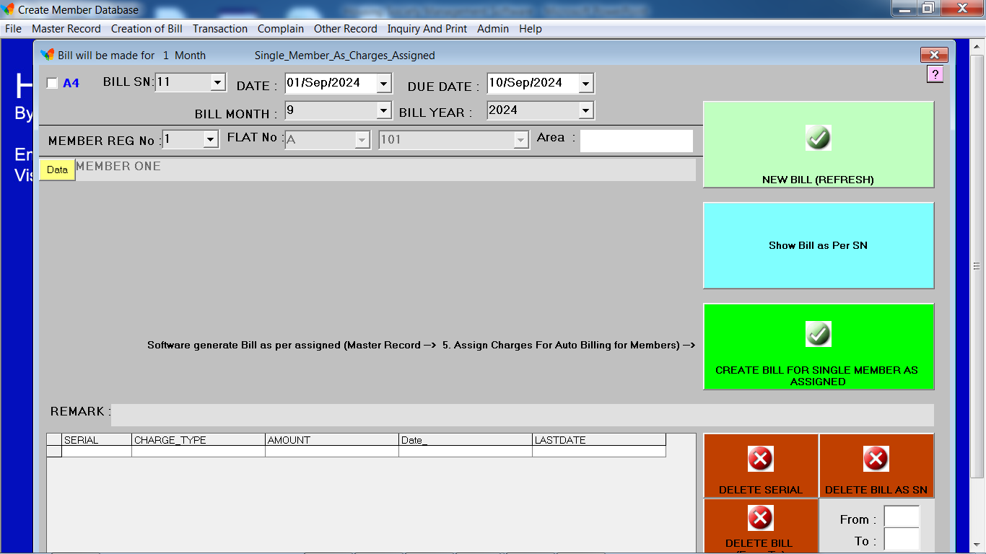
Housing Society Management Software
Desktop (Windows Based)

Slide 22
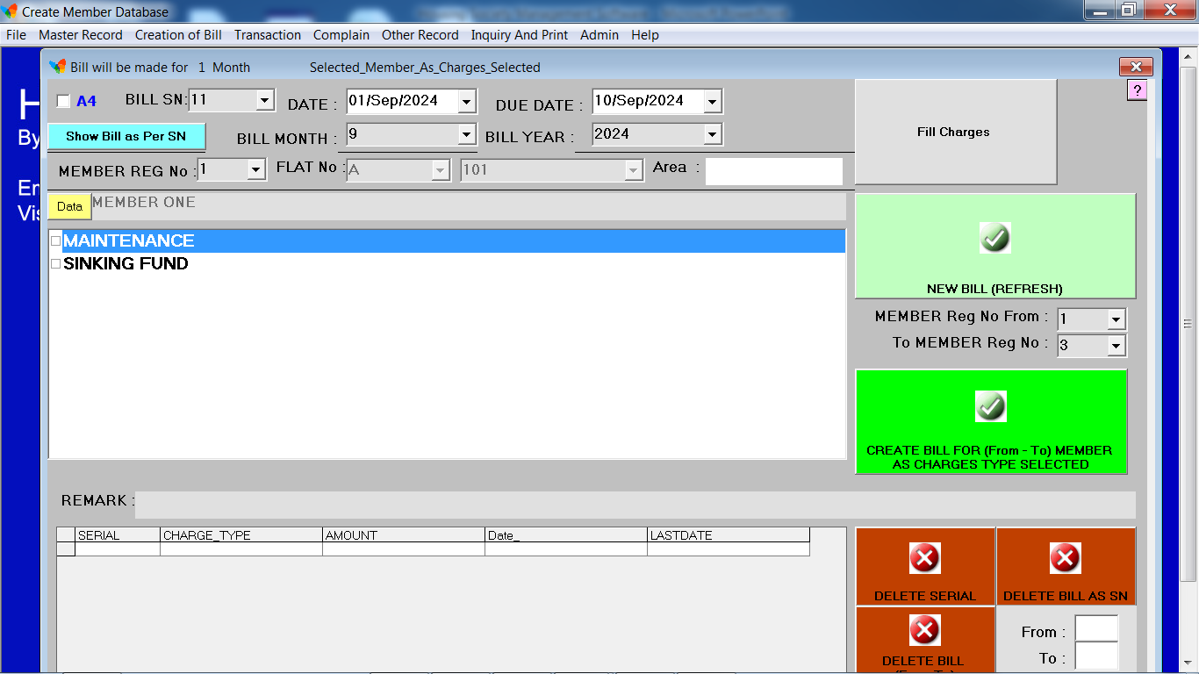
Housing Society Management Software
Desktop (Windows Based)

Slide 23
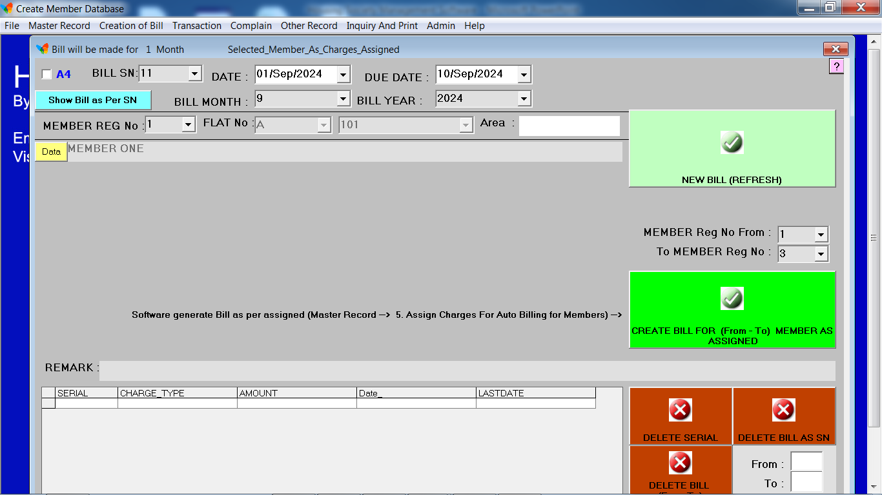
Housing Society Management Software
Desktop (Windows Based)

Slide 24
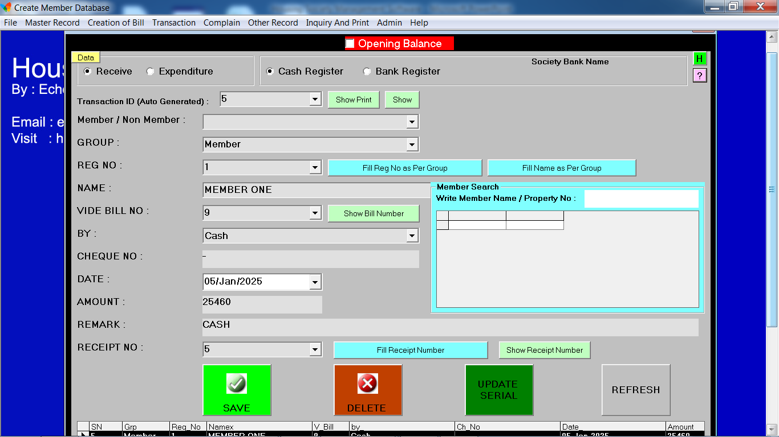
Housing Society Management Software
Desktop (Windows Based)

Slide 25
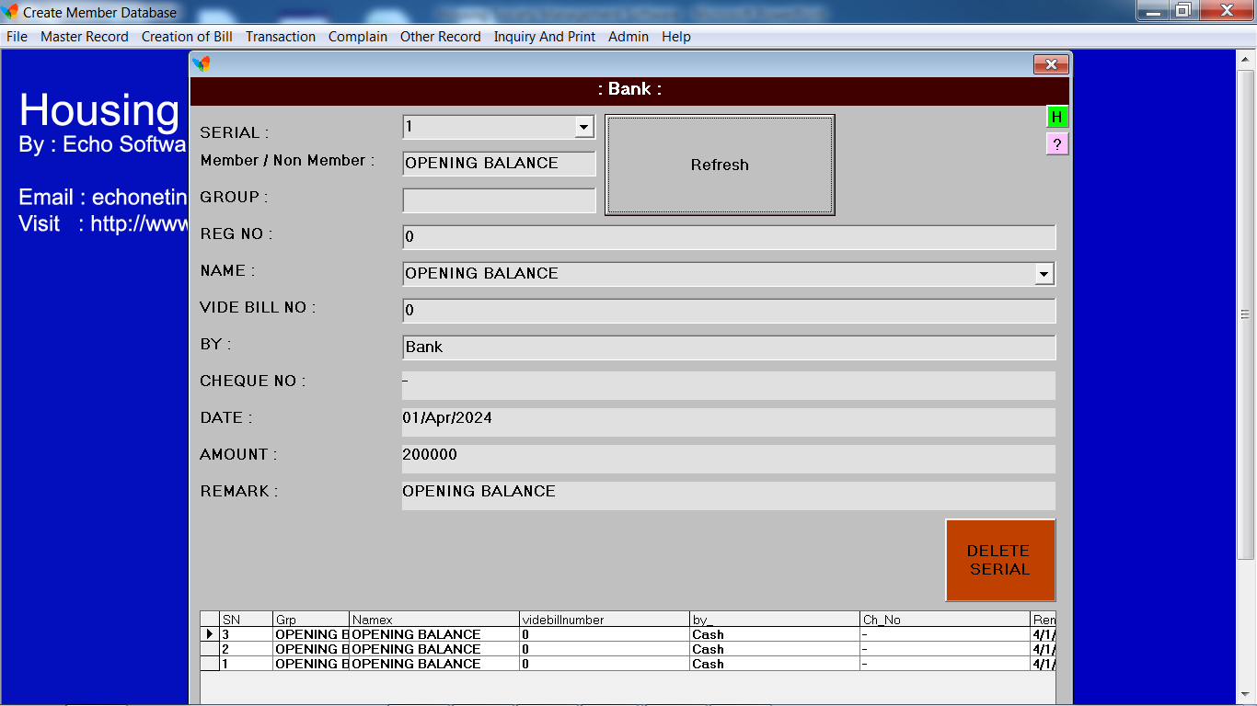
Housing Society Management Software
Desktop (Windows Based)

Slide 26
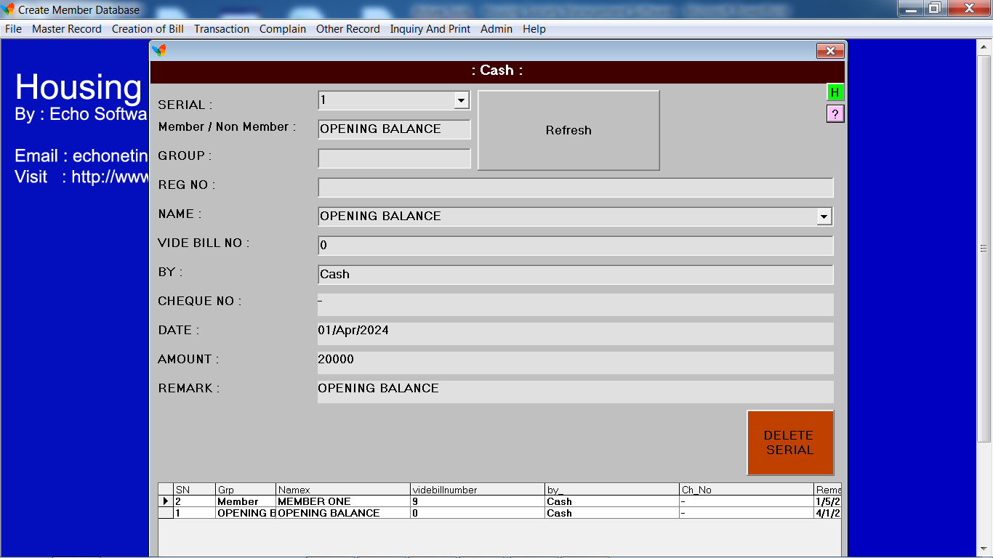
Housing Society Management Software
Desktop (Windows Based)

Slide 27
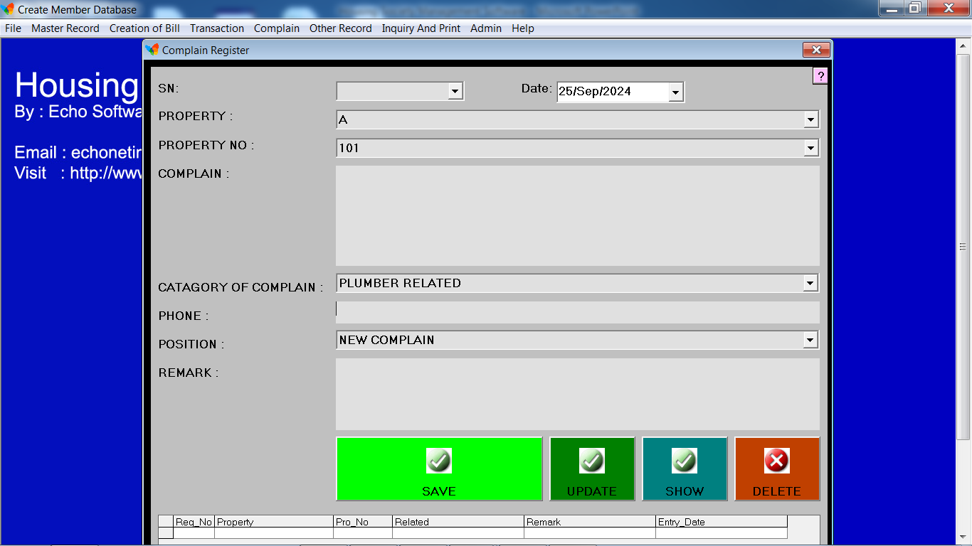
Housing Society Management Software
Desktop (Windows Based)

Slide 28
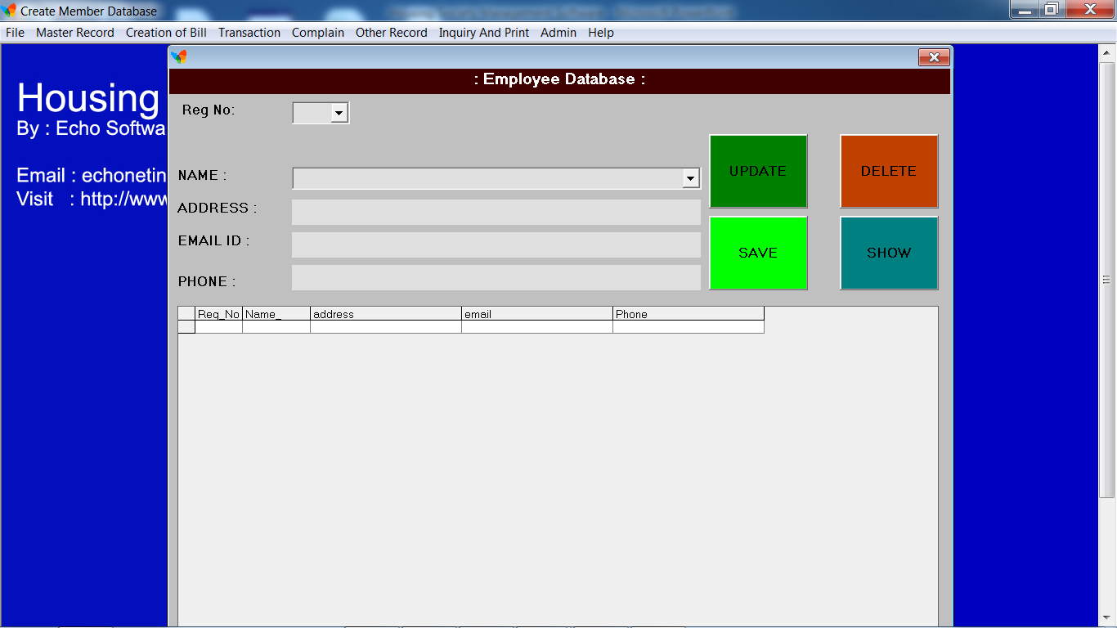
Housing Society Management Software
Desktop (Windows Based)

Slide 29
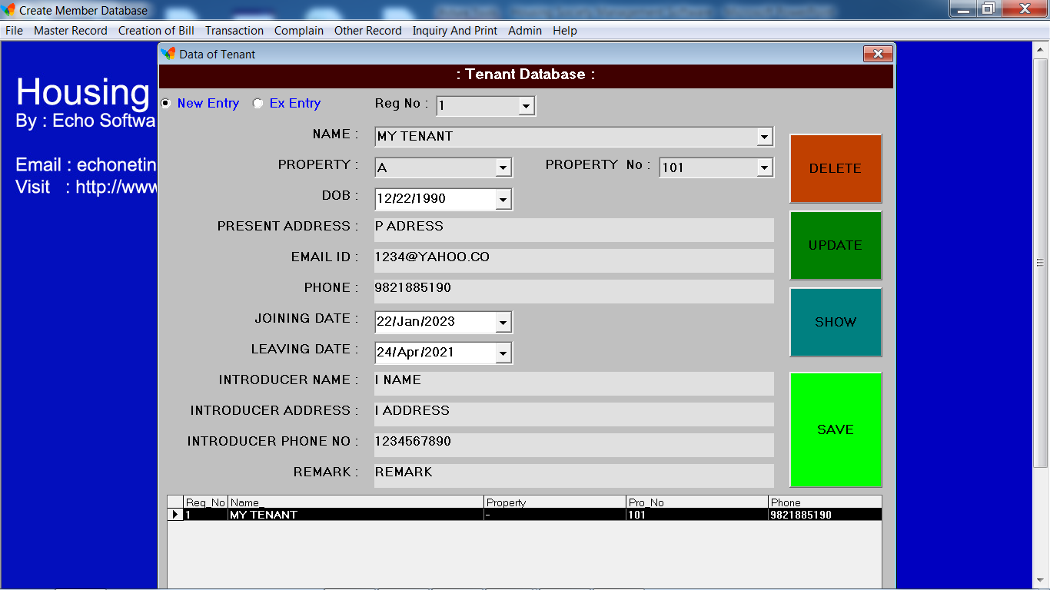
Housing Society Management Software
Desktop (Windows Based)

Slide 30
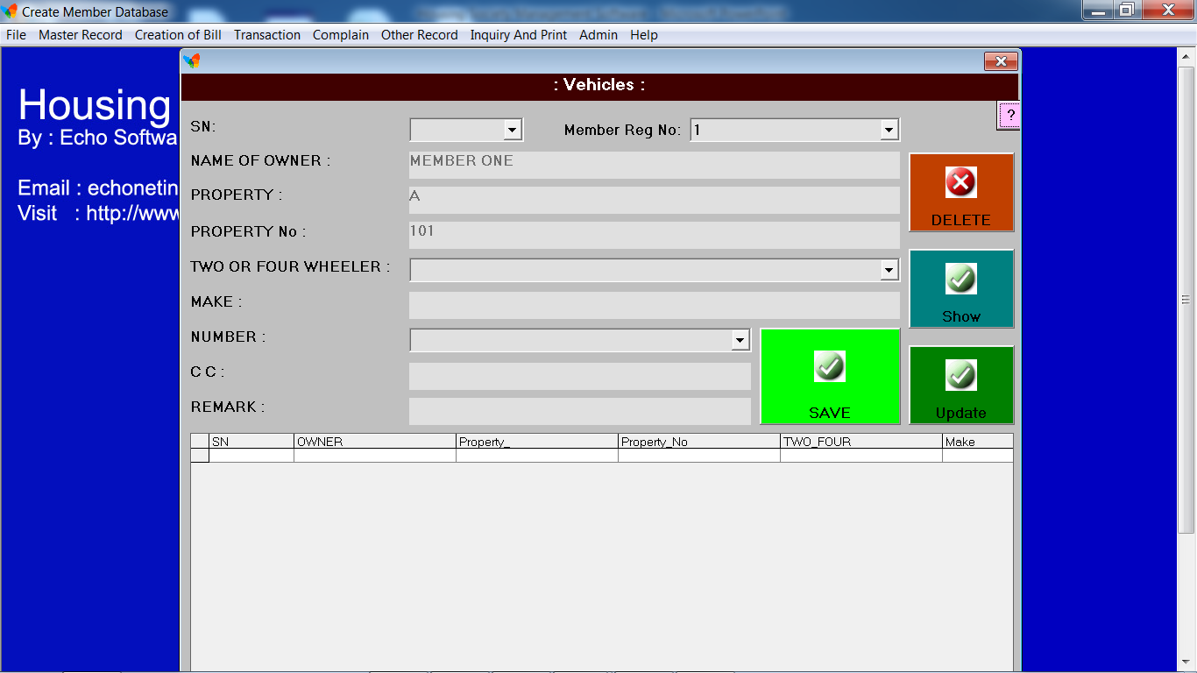
Housing Society Management Software
Desktop (Windows Based)

Slide 31
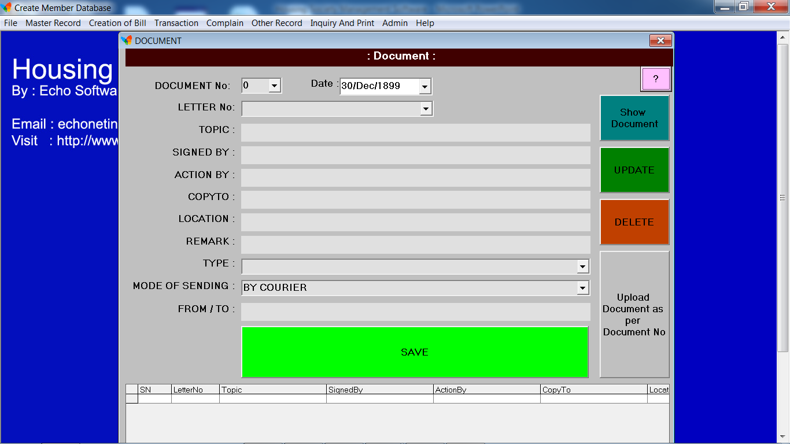
Housing Society Management Software
Desktop (Windows Based)

Slide 32
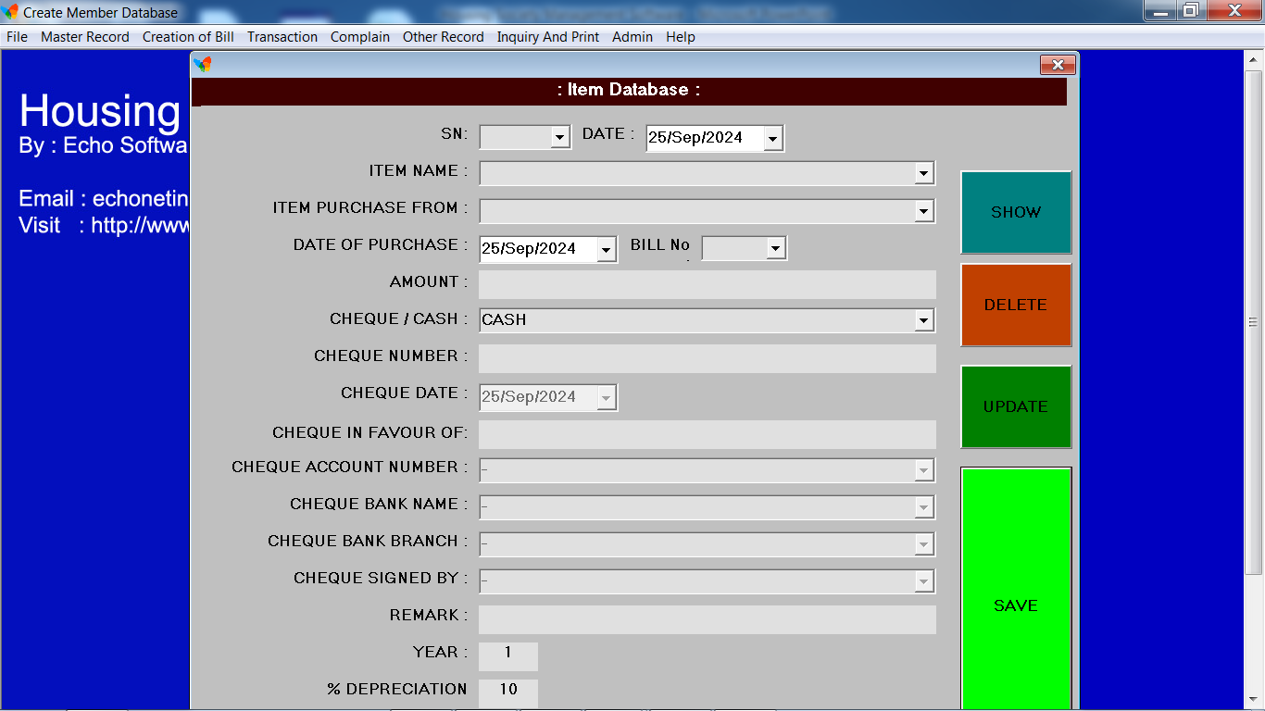
Housing Society Management Software
Desktop (Windows Based)

Slide 33
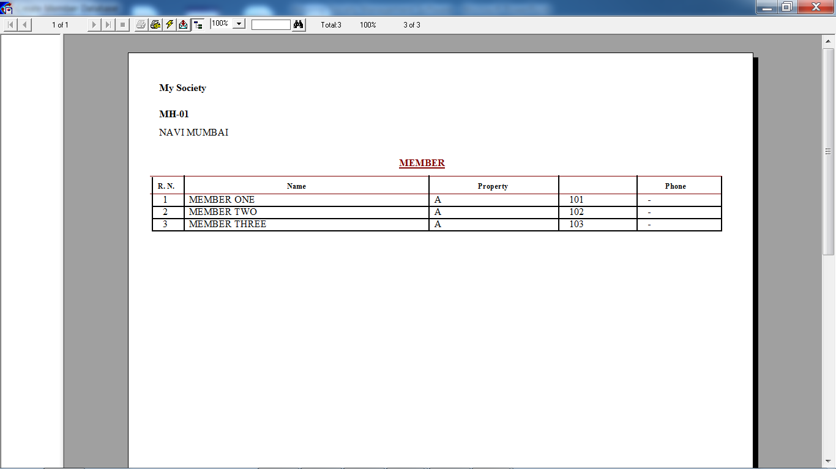
Housing Society Management Software
Desktop (Windows Based)

Slide 34
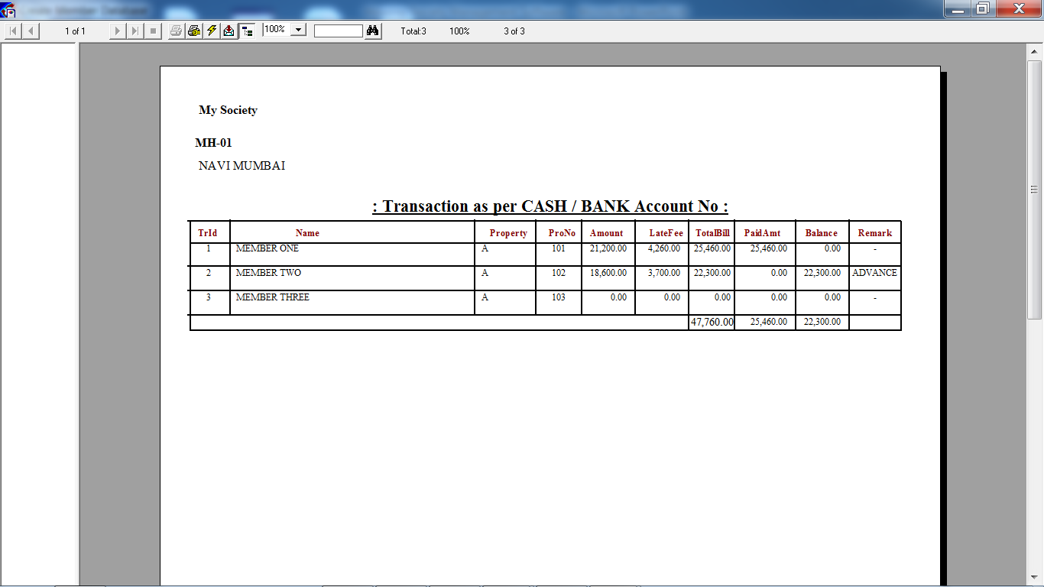
Housing Society Management Software
Desktop (Windows Based)

Slide 35
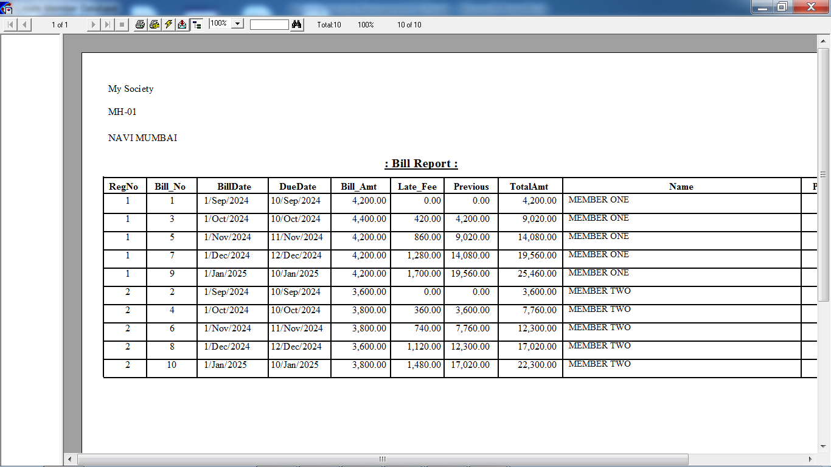
Housing Society Management Software
Desktop (Windows Based)

Slide 36
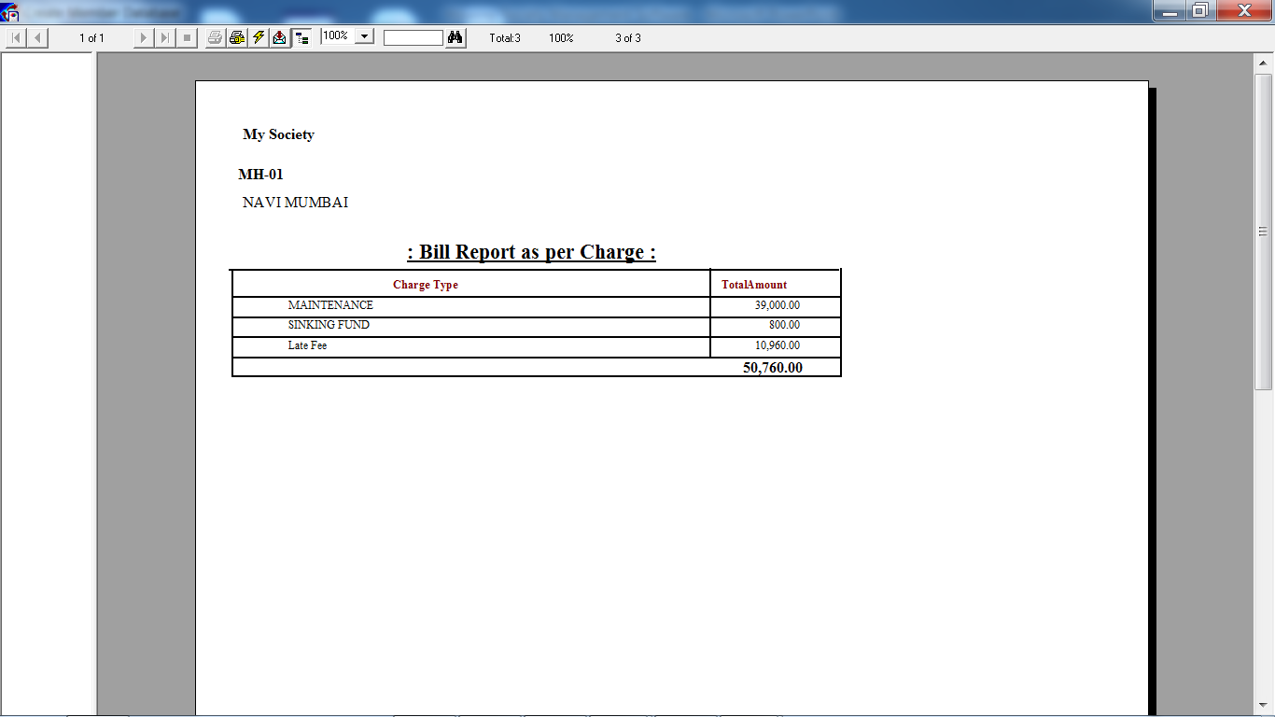
Housing Society Management Software
Desktop (Windows Based)

Slide 37
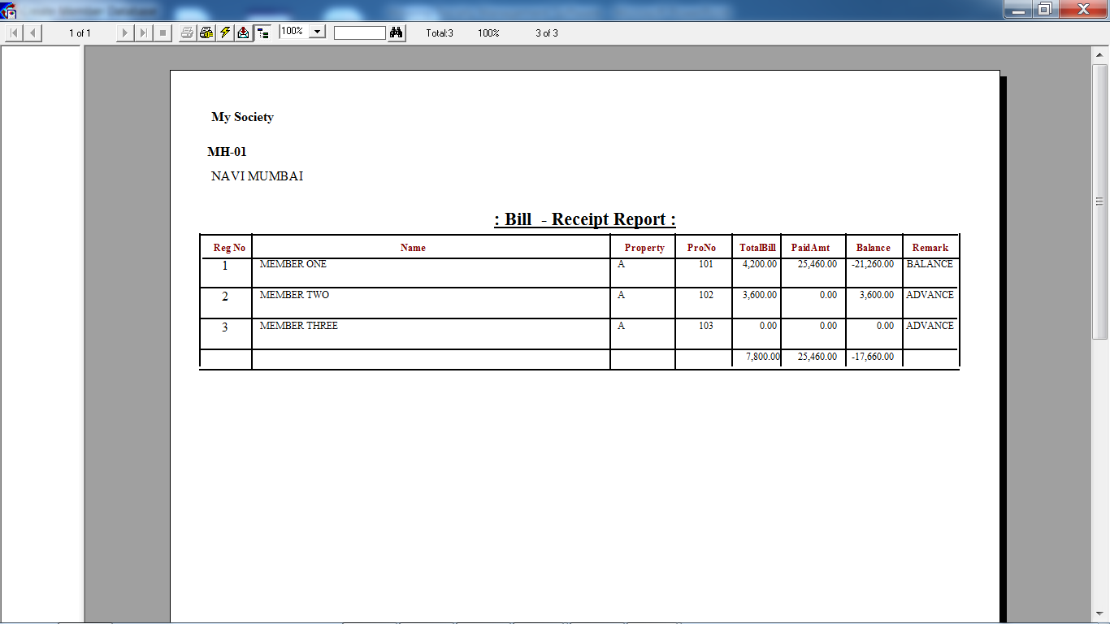
Housing Society Management Software
Desktop (Windows Based)

Slide 38
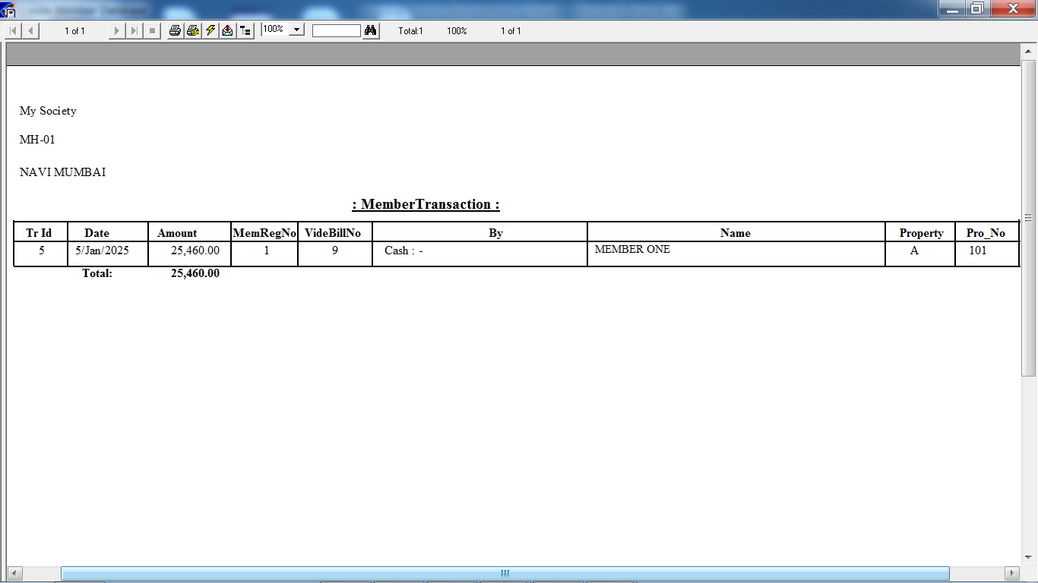
Housing Society Management Software
Desktop (Windows Based)

Slide 39
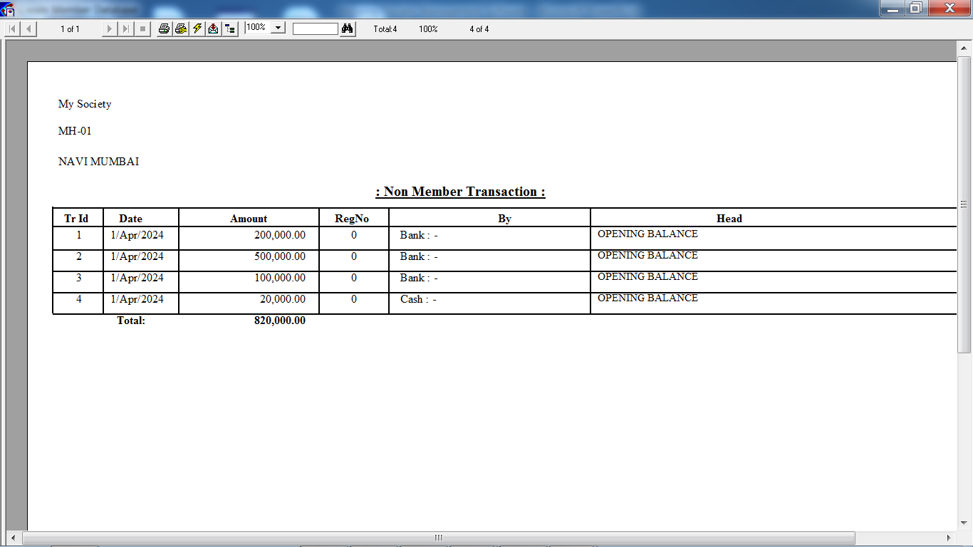
Housing Society Management Software
Desktop (Windows Based)

Slide 40
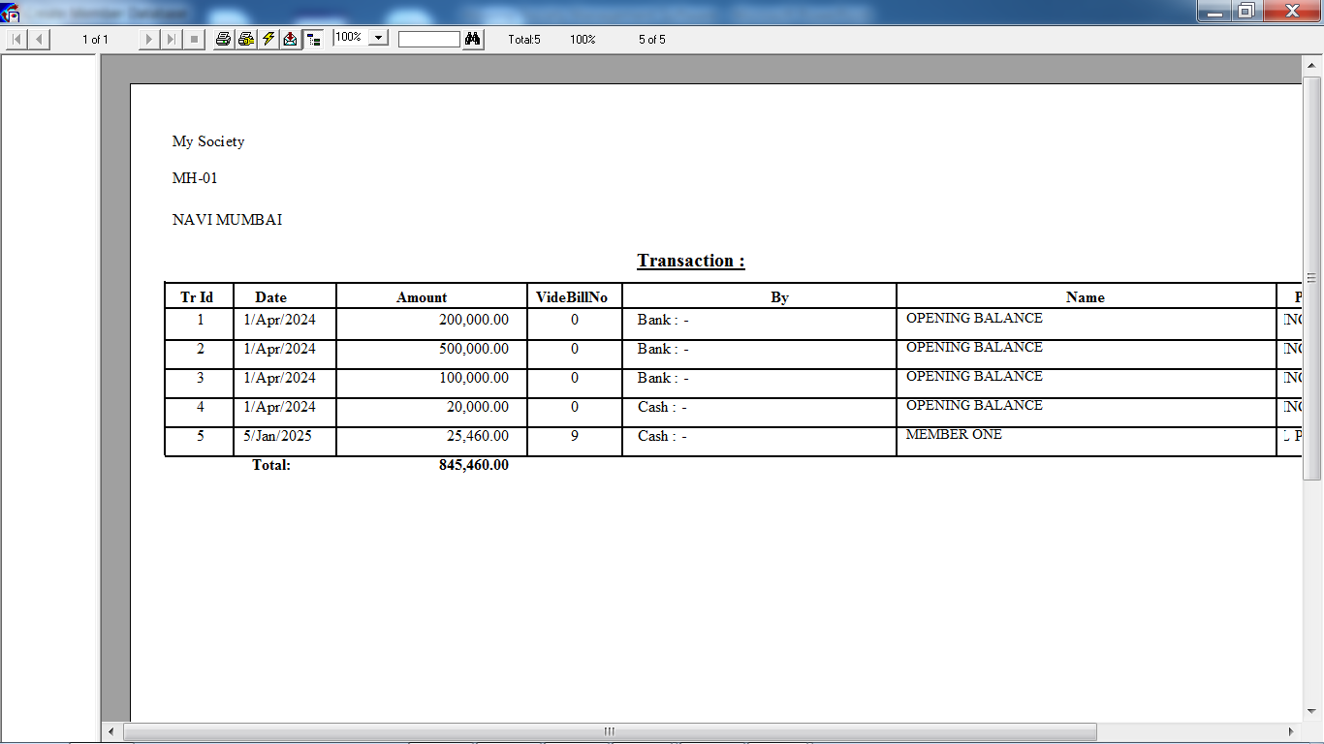
Housing Society Management Software
Desktop (Windows Based)

Slide 41
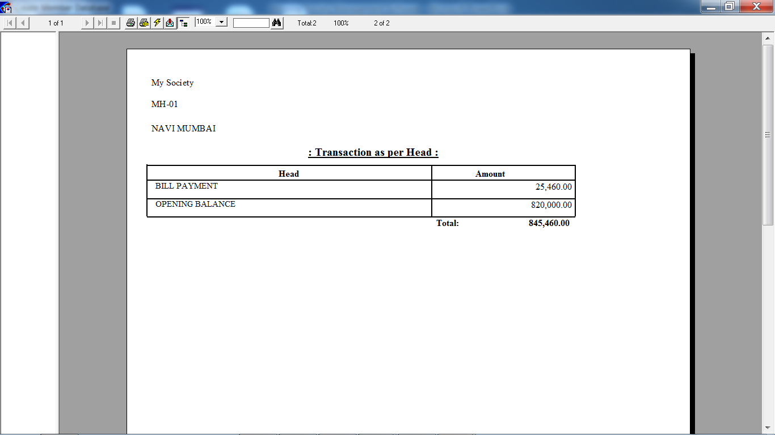
Housing Society Management Software
Desktop (Windows Based)

Slide 42
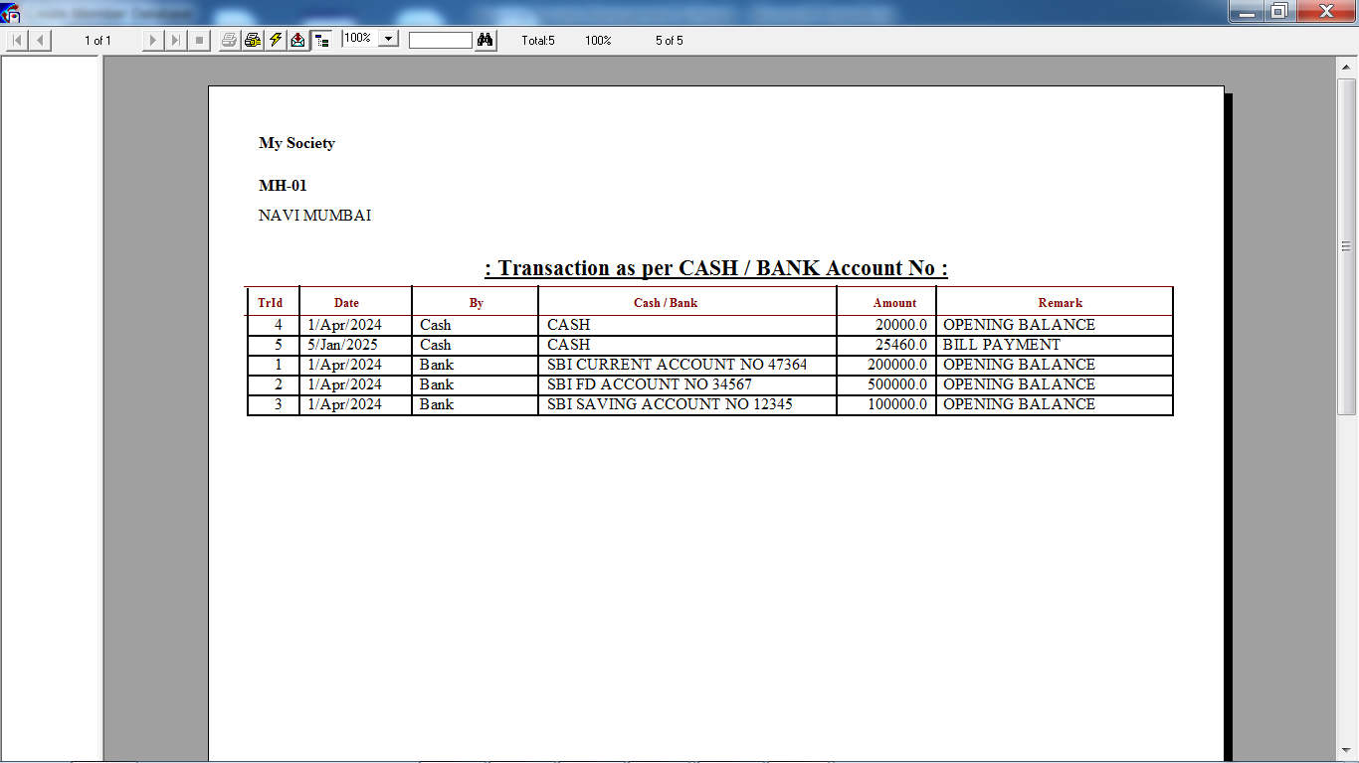
Housing Society Management Software
Desktop (Windows Based)

Slide 43
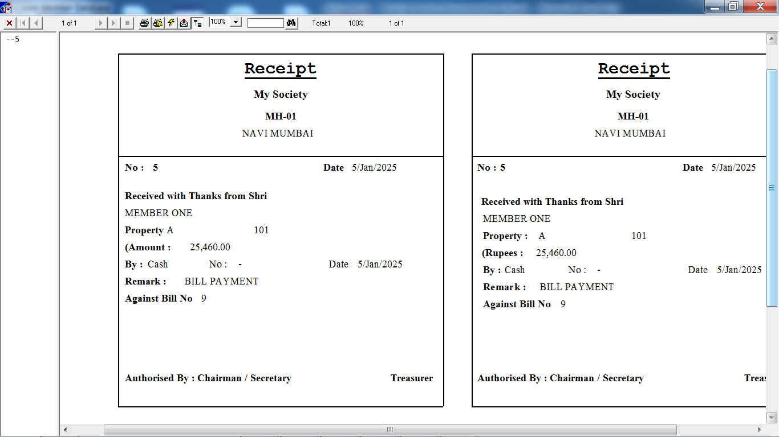
Housing Society Management Software
Desktop (Windows Based)

Slide 44
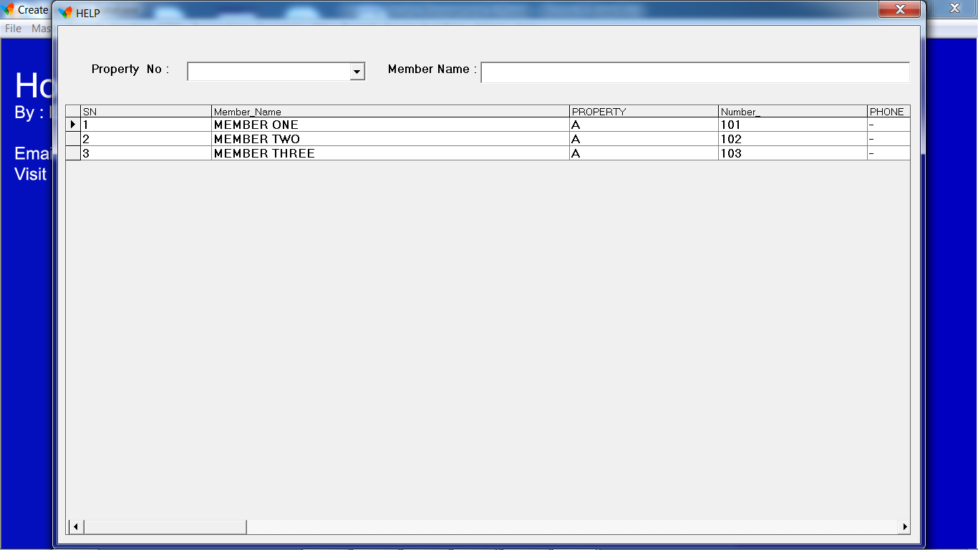
Housing Society Management Software
Desktop (Windows Based)

Slide 45
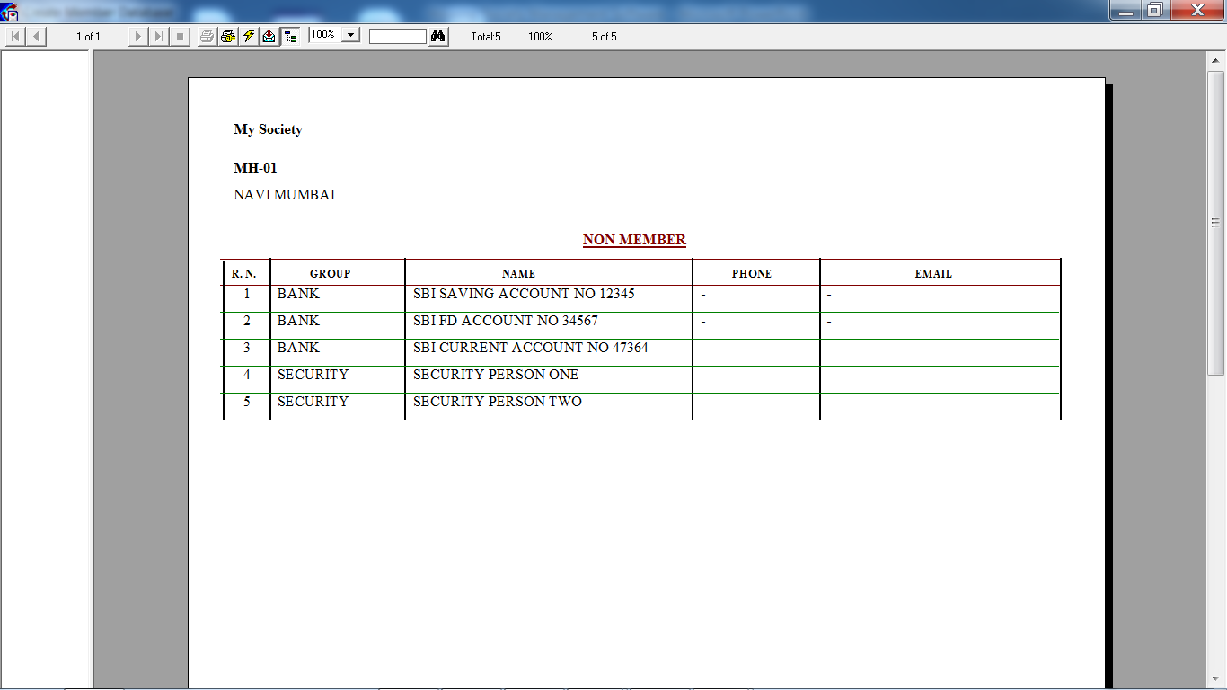
Housing Society Management Software
Desktop (Windows Based)

Slide 46
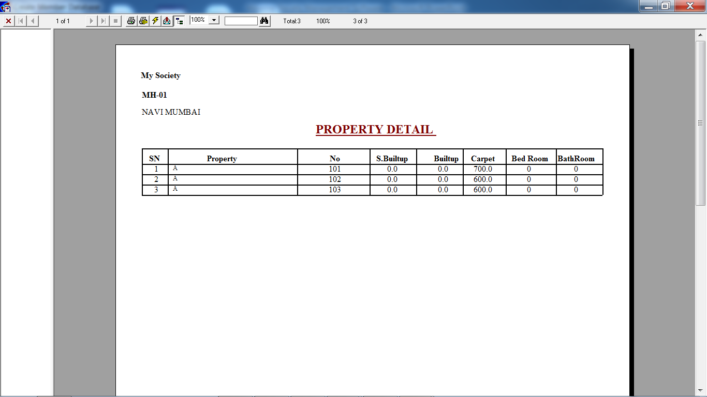
Housing Society Management Software
Desktop (Windows Based)

Slide 47
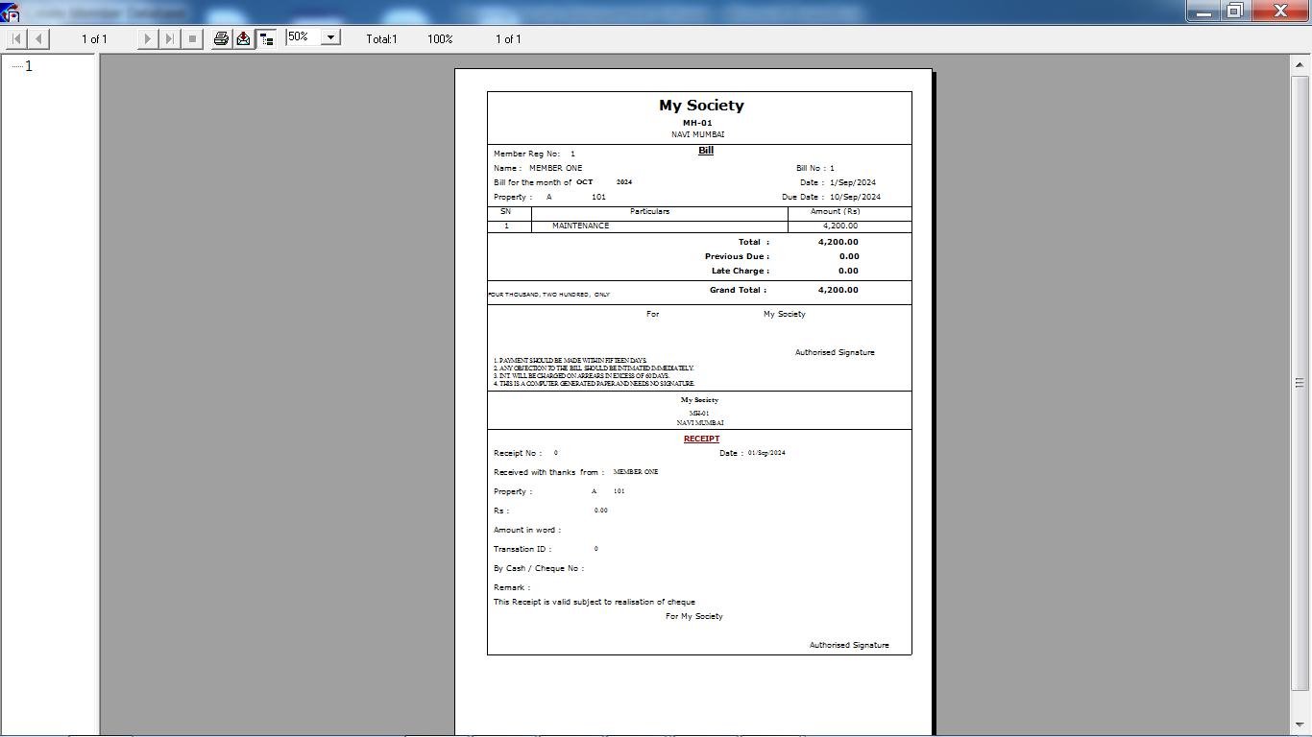
Housing Society Management Software
Desktop (Windows Based)

Slide 48
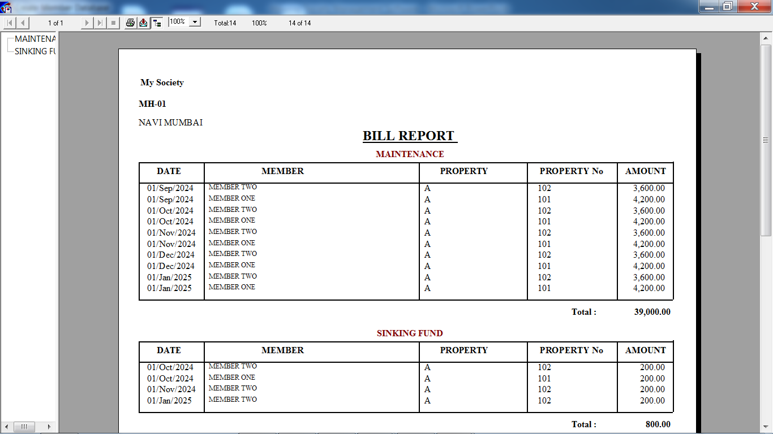
Housing Society Management Software
Desktop (Windows Based)

Slide 49
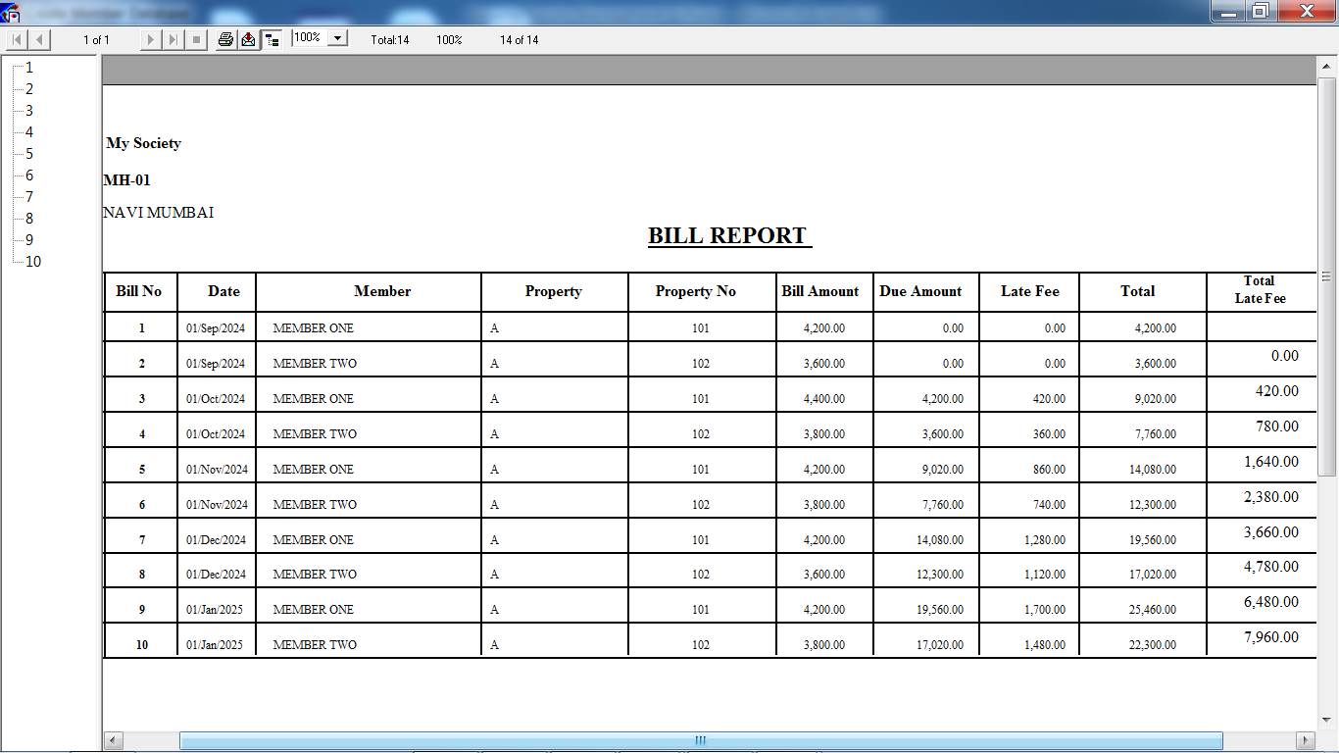
Housing Society Management Software
Desktop (Windows Based)

Slide 50
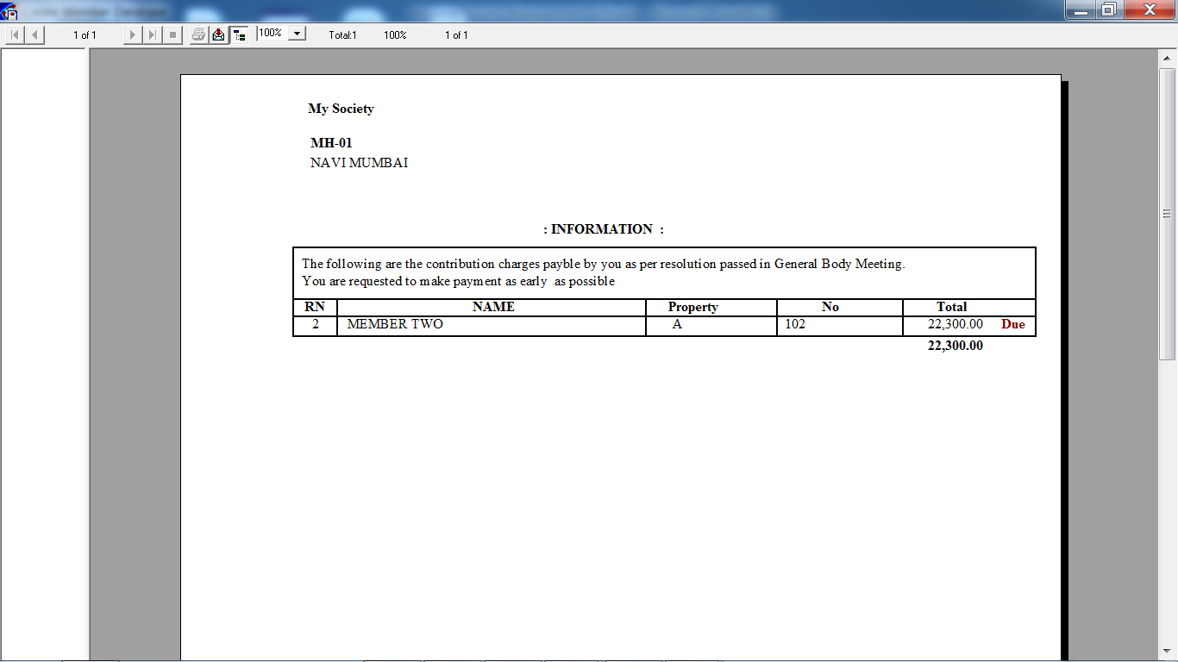
Housing Society Management Software
Desktop (Windows Based)

Slide 51
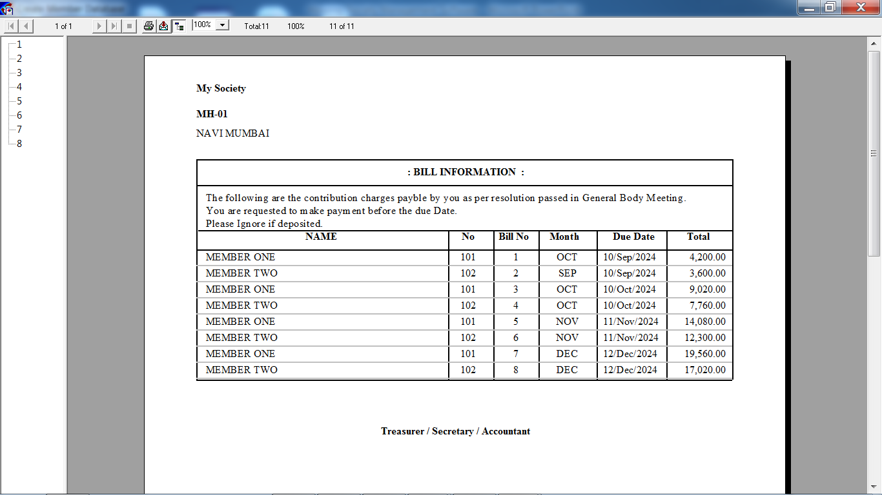
Housing Society Management Software
Desktop (Windows Based)

Slide 52

Housing Society Management Software
Desktop (Windows Based)

Slide 53

Housing Society Management Software
Desktop (Windows Based)

Slide 54

Housing Society Management Software
Desktop (Windows Based)

Slide 55

Housing Society Management Software
Desktop (Windows Based)

Slide 56

Housing Society Management Software
Desktop (Windows Based)

Slide 57

Housing Society Management Software
Desktop (Windows Based)

Slide 58

Housing Society Management Software
Desktop (Windows Based)

Slide 59

Housing Society Management Software
Desktop (Windows Based)

Slide 60

Housing Society Management Software
Desktop (Windows Based)

Slide 61

Housing Society Management Software
Desktop (Windows Based)

Slide 62

Housing Society Management Software
Desktop (Windows Based)

